Slide 1



Investment needs in water and wastewater infrastructure in fulfilling SDG 6
Cost recovery constraints in water infrastructure development
Bankable and sustainable WASH Solutions to overcome affordability barriers limiting the mobilization of private capital
Dr Károly KOVÁCS
Chairman, HWP Past president, EWA

Slide 2
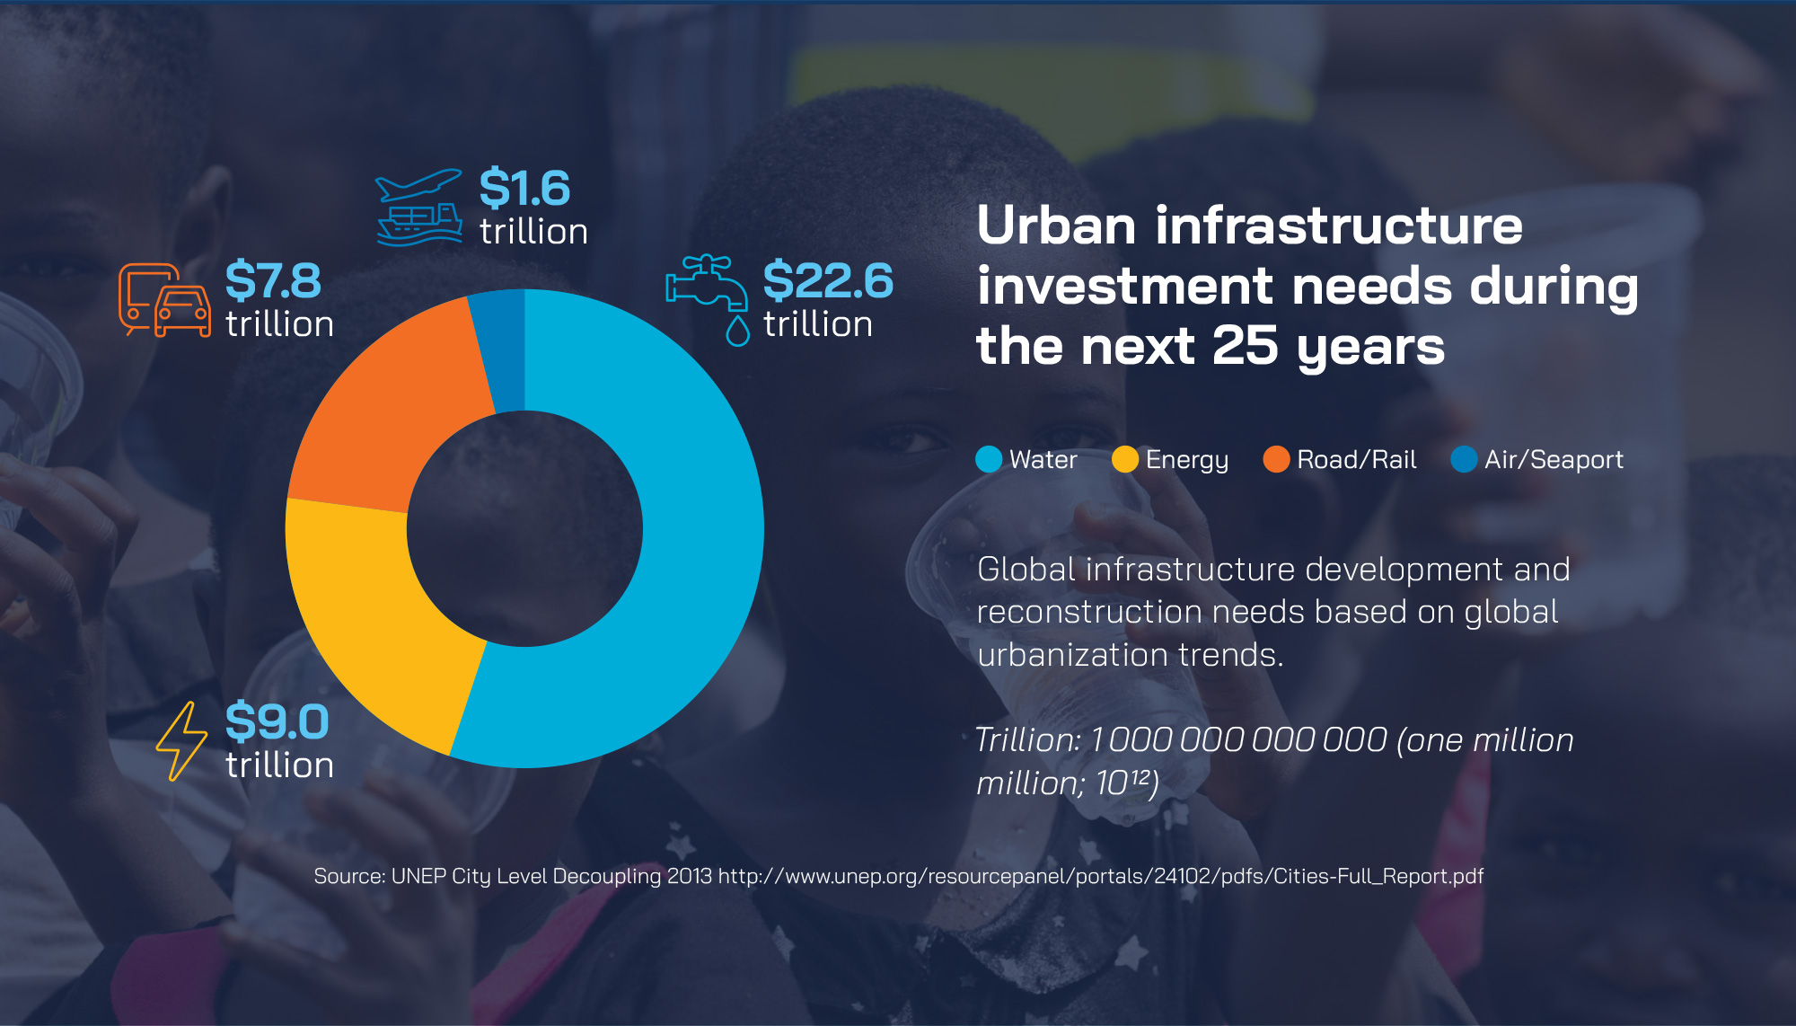
Source: UNEP City Level Decoupling 2013
http://www.unep.org/resourcepanel/portals/24102/pdfs/Cities-Full_Report.pdf

Slide 3
Water infrastructure situation Europe
Water utility infrastructure financing in Europe :
underfinanced reconstruction of existing, aging infrastructure
1%-0,01% reconstruction/year
Not inclusion of capital costs into tariffs
EU public funding equal to conditions of 50 years payback period of interest-free finance BUT
cost recovery of 2%/year of the initial invested capital not provided due to affordability constraints

Slide 4
Full-scale water and sanitation investments
Infrastructure investments needs/capita to provide 100 liter/capita/day drinking water and the full-scale collection and treatment of polluted wastewater
>> depending on local conditions and size of municipality
1 500 – 7 500 EUR/capita (investment costs water supply, wastewater collection and treatment)
with the collection and distribution network fluctuating between 1 200 –5 700 €/capita (75–80% of the total) depending on local conditions, but mainly on the size of the municipalities – the smaller the more expensive.
85 -170 EUR/capita/year (operational costs)

Slide 5

EU asset evaluation – UNEP City-Level Decoupling Report
22 600 billion USD >> impossible to be funded and invested
Dividing the 22 600 billion USD by the number of the population (6 billion in 2050) living in cities as indicated in the report, we are coming to 3 500–4 000 USD/capita investment needs
If the world’s richest regions full scale and inclusive water infrastructure development is unbankable, then how do we expect it to be worldwide?

Slide 6

Near the consumer solutions
to provide at least 3 litres per person per day of safe and affordable drinking water for a healthy life

Slide 7

Near the consumer solutions
to provide the proper collection and treatment of the wastewater/liquid waste, septic sludge of communities without sewerage networks

Slide 8
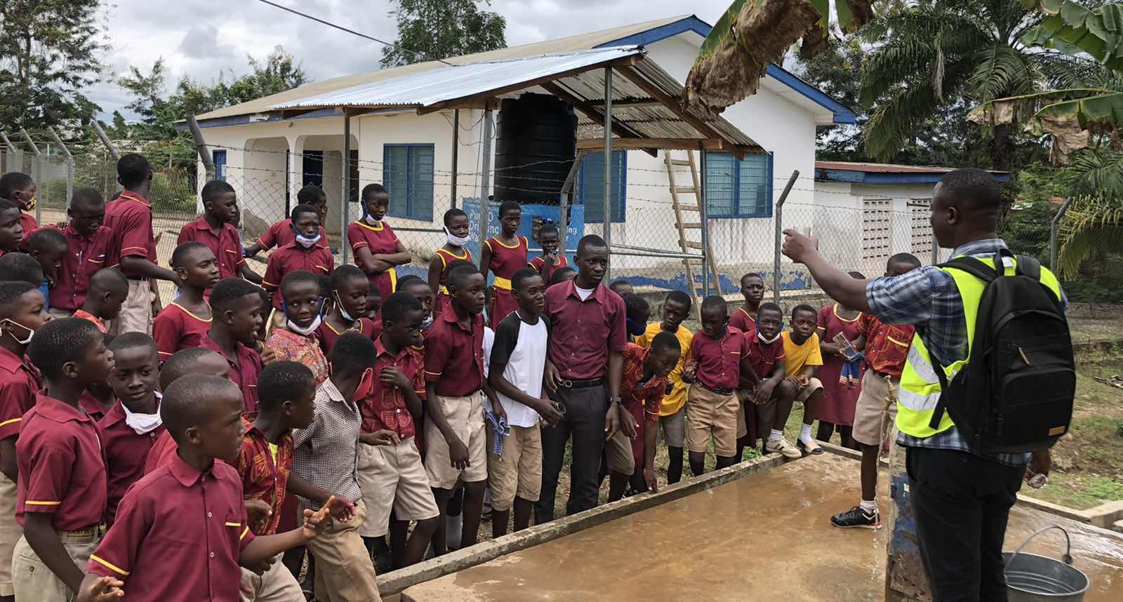
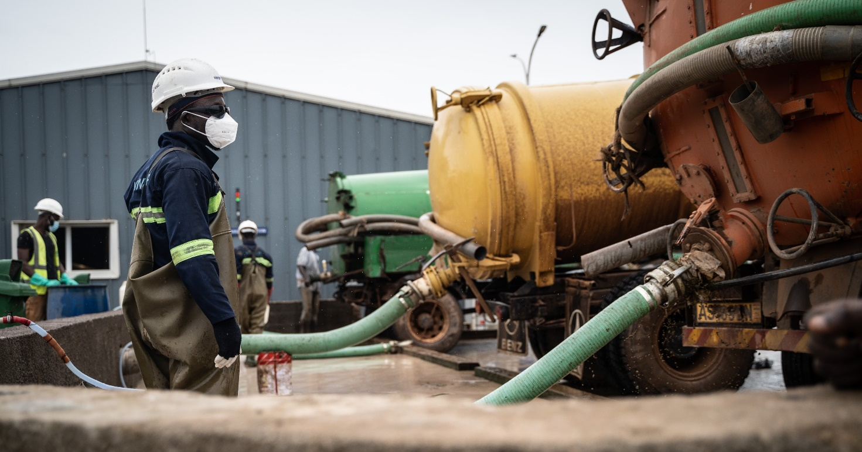
Near the consumer solutions

Slide 9

Near the consumers water infrastructure investments
Infrastructure investments needs/capita to provide 3 liter/capita/day drinking water and the proper collection and treatment of polluted wastewater >> depending on local conditions and size of municipality
< 70 EUR/capita (investment costs water supply, wastewater collection and treatment)
< 15 EUR/capita/year (service costs, including capital cost recovery)
Listed by the UN as SDG acceleration technologies
https://sdgs.un.org/partnerships/sustainable-safe-drinking-water-supply-rural-areas-point-technology-giving-instant
https://sdgs.un.org/partnerships/affordable-wastewater-treatment-technology-treat-100-liquid-waste-faecal-sludge-value

Slide 10
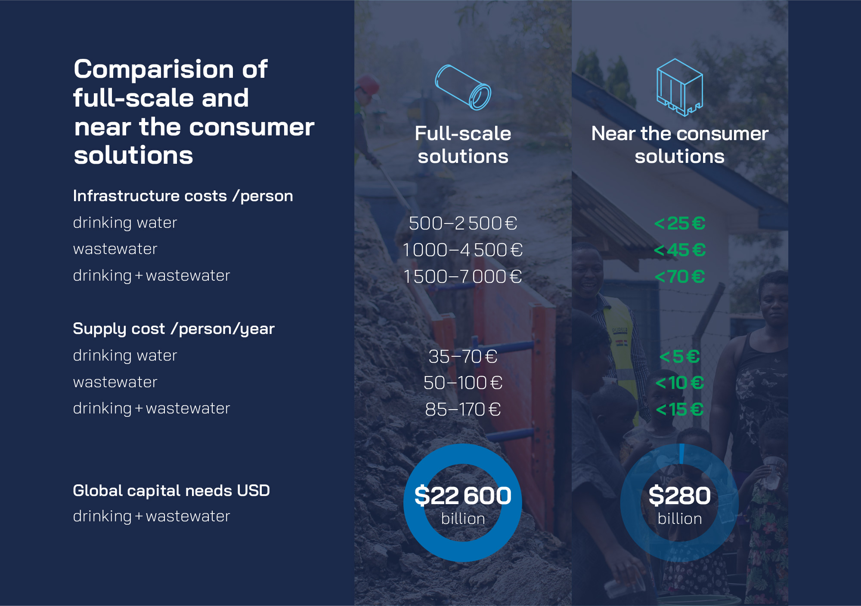

Slide 11
The impact of implementation of alternative near-the-consumer solutions
reduction of required investment capital by nearly 99%,
safe drinking water provision for less than 5 €/person/year,
liquid waste management, and purification service of less than 10 €/person/year,
affordable WASH services, with tariffs including initial capital costs,
return on the invested capital → involvement of private capital.

Slide 12
Message to take
BE AWARE:
Full-scale city level investment needs (3-5.000 USD/cap) are unrealistic to be funded and invested.
SUPPORT:
Near to consumers solutions are affordable, sustainable, bankable and available

Slide 13
Thank you for your attention!
www.hungarianwaterpartnership.com

